Slide 1
Chapter 19
Carrying Out an Empirical Project

Slide 2
Carrying Out an Empirical Project (1 of 23)
Goal of this chapter
Learn how to complete a term project/write a term paper.
Posing a question
Knowing precisely what question you want to answer is essential.
You can only collect your data if you exactly know your question.
You can only know whether you can complete your project in the allotted time if you know whether the necessary data is available.
You can only know if your research question is of interest to someone if you can precisely state it and discuss it with your class mates/instructor.

Slide 3
Carrying Out an Empirical Project (2 of 23)
Finding interesting research questions
Choose the area of economics/social sciences you are interested in.
Examples for typical research questions
Labor Economics: Explaining wage differentials
Public Economics: Effect of taxes on economic activity
Education Economics: Effect of spending on school performance
Macroeconomics: Effect of investment on GNP growth
Look for published papers on the chosen topic using tools such as EconLit, Google Scholar, the Journal of Economic Literature (JEL) etc.

Slide 4
Carrying Out an Empirical Project (3 of 23)
Your research project should add something new
Add a new variable whose influence has not been studied before
Expand economic questions to include factors from other sciences
Study an existing question for more recent data (may be boring)
Use a new data set or study a question for a different country
Try out new/alternative methods to study an old question
Find a completely new question (hard but possible)
It helps if your research question is policy relevant or of local interest

Slide 5
Carrying Out an Empirical Project (4 of 23)
Literature review
A literature review is important to place your paper into context.
Use online search services to systematically search for literature.
When searching, think of related topics that may also be relevant.
A literature review can be part of the introduction or a separate section.
Data collection
Most questions can be addressed using alternative types of data (pure cross-sections, repeated cross-sections, time series, panels).

Slide 6
Carrying Out an Empirical Project (5 of 23)
Deciding on the appropriate data set
Many questions can in principle be studied using a single cross-section
But for a reasonable ceteris paribus analysis one needs enough controls
Panel data provides more possibilities for convincing ceteris paribus analyses as one can control for time-invariant unobserved effects
Examples for panel data sets: PSID (individuals), Compustat (firms)
Panel data for cities, counties, states etc. are often publicly available
Data sets are often available online, in journal archives, or from authors

Slide 7
Carrying Out an Empirical Project (6 of 23)
Entering and storing your data
Data formats: 1) printed, 2) ASCII, 3) spreadsheet, 4) software specific
Important identifiers: 1) observational unit, 2) time period
Time series must be ordered according to time period
Panel data are conveniently ordered as blocks of individual data
It is always important to correctly identify and handle missing values
Nonnummerical data also have to be handled with great care
Software specific formats often provide good ways of documentation

Slide 8
Carrying Out an Empirical Project (7 of 23)
Inspecting, cleaning, and summarizing your data
It is extremely important to become familiar with your data set.
Even data sets that were used before may contain problems/errors.
Look at individual entries/try to understand the structure of your data.
Understand how missing values are coded; if they are coded as “999” or “-1”, this can be extremely dangerous for your analysis.
It is better to use nonnummerical values for missing values.
Understand the units of measurement of your variables.

Slide 9
Carrying Out an Empirical Project (8 of 23)
Inspecting, cleaning, and summarizing your data
Know whether your data is real/nominal, seasonally adjusted/unadjusted
Check if means, std.dev., mins, and maxs of your data are plausible
Clean your data of implausible values and obvious coding errors
When making data transformations (differencing, growth rates) make sure your data is correctly ordered and no wrong operations result
For example, in a panel data set, be aware that the first observation of each cross-sectional unit has no predecessor

Slide 10
Carrying Out an Empirical Project (9 of 23)
Econometric Analysis
Given your research question and the data available, you have to decide on the appropriate econometric methods to use.
Some general guidelines
OLS is still the most widely used method and often appropriate.
Make sure the key assumptions are satisfied in your model.
Always check for possible problems of omitted variables, self-selection, measurement error, and simultaneity.

Slide 11
Carrying Out an Empirical Project (10 of 23)
Some general guidelines
Carefully choose functional form specifications (logs, squares etc.).
Beginners mistake: do not include variables that are listed as numerical values but have no quantitative meaning (e.g., 3-digit occupations).
Transform such variables to dummy variables representing categories.
Handle ordinal regressors in a similar way (e.g., job satisfaction).
For ordinal dependent variables, there are ordered logit/probit models.
One can also reduce ordered variables to binary variables.

Slide 12
Carrying Out an Empirical Project (11 of 23)
Some general guidelines
Think of secondary complications such as heteroskedasticity.
Specific problems in time series regressions: 1) levels vs. differences, 2) trends and seasonality, 3) unit roots and cointegration
Carry out misspecification tests and think about possible biases.
Sensitivity analysis: look at variations of your specification/method.
Hopefully, results do not change in a substantial way.
Are there problems with outliers/influential observations?

Slide 13
Carrying Out an Empirical Project (12 of 23)
Specific aspects to think of when using panel data
Key assumptions
Random effects: regressors unrelated to individual specific effects
Fixed effects: regressors related to individual specific effects
The fixed effects assumption is often more convincing
Contemporaneous exogeneity: idiosyncratic errors are uncorrelated with the explanatory variables of the same time period
Strict exogeneity: idiosyncratic errors are uncorrelated with the explanatory variables of all time periods (often problematic)

Slide 14
Carrying Out an Empirical Project (13 of 23)
Specific aspects to think of when using panel data
Methods for panel data
Pooled OLS: random effects assumption, serial correlation of error terms, needs only contemporaneous exogeneity.
Random effects estimation: random effects assumption, more efficient than pooled OLS, needs strict exogeneity.
Fixed effects estimation: fixed effects assumption, problem with time invariant regressors, needs strict exogeneity.
First differencing: similar to fixed effects, good for longer time series.

Slide 15
Carrying Out an Empirical Project (14 of 23)
Data mining/specification searches
The process of looking for the best model is called specification search.
Often, one starts with a general model and drops insignificant variables.
If the specification search entails many steps, this is problematic.
Our assumptions actually require that the model is only estimated once.
If one sequentially estimates a number of models on the same data, the resulting test statistics and p-values cannot be interpreted anymore.
This (difficult) problem is often ignored in practice.
One should keep the number of specification steps to a minimum.

Slide 16
Carrying Out an Empirical Project (15 of 23)
Writing an empirical paper
A succesful empirical paper combines a careful, convincing data analysis with good explanations and a clear exposition.
Introduction
State basic objectives and explain why the topic is important.
Literature review: What has been done? How do you add to this?
Grab the reader‘s attention by presenting simple statistics, paradoxical evidence, topical examples, or challenges to common wisdom.
One may give a short summary of results in the introduction.

Slide 17
Carrying Out an Empirical Project (16 of 23)
Conceptual (or theoretical) framework
Description of general approach to answering your research question.
You may delevop/use a formal economic model for this.
For example, setting up a utility maximization model of criminal activity clarifies the factors that matter for explaining criminal activity .
However, often common economic sense suffices to discuss the main mechanisms and control variables that have to be taken into account.
As one is in most cases interested in answering a causal question, a convincing discussion of what variables to control for is essential.

Slide 18
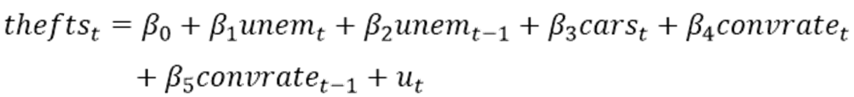
Carrying Out an Empirical Project (17 of 23)
Econometric models and estimation methods
Specify the population model you have in mind
Example: Effects of alcohol consumption on college GPA
Example: Time series model of city-level car thefts
Explain your functional form choices

Slide 19
Carrying Out an Empirical Project (18 of 23)
Econometric models and estimation methods
After specifying a population model, discuss estimation methods.
Describe how you measure the variables in your population model.
When using OLS: Discuss why exogeneity assumptions hold, and how you deal with heteroskedasticity, serial correlation, and the like.
When using IV/2SLS: Explain why your instrumental variables fulfill the assumptions: 1) exclusion, 2) exogeneity, 3) partial correlation.
When using panel methods: Explain what the unobserved individual specific effects stand for, and how they are removed/accounted for.

Slide 20
Carrying Out an Empirical Project (19 of 23)
Data
Carefully describe the data used in your empirical analysis.
Name the sources of your data and how they can be obtained.
Time series data and short data sets may be listed in the appendix.
If your data is self-collected, include a copy of the questionnaire.
Discuss the units of measurement of the variables of interest.
Present summary statistics for the variables used in the analysis.
For trending variables, growth rates or graphs are more appropriate.
Always state how many observations you use for different estimations.

Slide 21
Carrying Out an Empirical Project (20 of 23)
Results
Present estimated equations, or, if there are too many, present tables.
Always include things like R-squared and the number of observations.
Are your estimated coefficients statistically significant?
Are they economically significant? What is their magnitude?
If coefficients do not have the expected signs, this may indicate there is a specification problem, for example, omitted variables.
Relate differences between the results from different methods to the differences in the assumptions underlying these methods.

Slide 22
Carrying Out an Empirical Project (21 of 23)
Conclusion
Summarize main results and conclusions from them
Discuss caveats to the conclusions drawn
Suggest directions for further research
Style hints
Choose a title that is exciting and reflects the paper‘s topic
Papers should be typed and double-spaced
Number equations, graphs, and tables
Refer to papers by author and date, for example, White (1980)

Slide 23
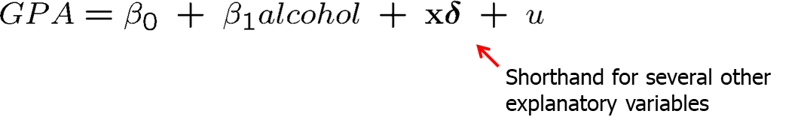
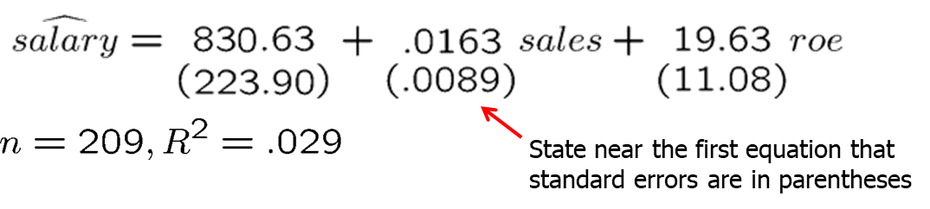
Carrying Out an Empirical Project (22 of 23)
Style hints
When you introduce an equation, describe important variables
In order to focus on a particular variable you may write something like
Presenting results in equation form:

Slide 24
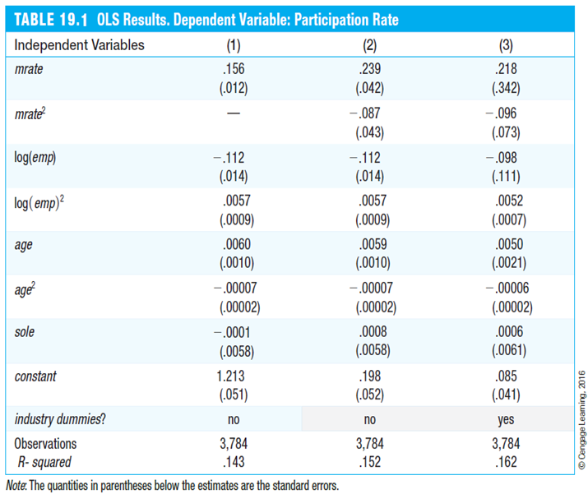
Carrying Out an Empirical Project (23 of 23)
Style hints
Independent Variables | (1) | (2) | (3)
Mrate | .156 (.012) | .239 (.042) | .218 (.342)
Mrate squared | - | -.087 (.043) | -.096 (.073)
Log(emp) | -.112 (.014) | -.112 (.014) | -.098 (.111)
Log(emp) squared | .0057 (.0009) | .0057 (.0009) | .0052 (.0007)
Age | .0060 (.0010) | .0059 (.0010) | .0050 (.0021)
Age squared | -.00007 (.00002) | -.00007 (.00002) | -.00006 (.00002)
Sole | -.0001 (.0058) | .0008 (.0058) | .0006 (.0061)
Constant | 1.213 (.051) | .198 (.052) | .085 (.041)
Industry dummies? | no | no | yes
Observations | 3,784 | 3,784 | 3,784
R squared | .143 | .152 | .162
Reporting results in tabular form:
Clearly indicate dependent and independent variables.
Limit the number of digits reported after the decimal point.
You may also think of rescaling your variables so that coefficients are not too large or too small.

